Slide 1
Medway and Swale Health & Care Partnership – VCSE Statutory & Mandatory Training matrix
November 2022

Slide 2







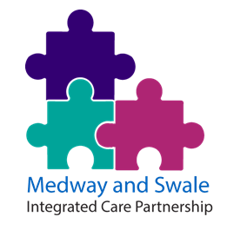








Medway & Swale H&CP PHM membership
Sheppey
Primary Care Network
Medway Central
Primary Care Network

Slide 3
VCSE MoU
& Framework

Slide 4

Medway and Swale Voluntary and Community Sector
– Framework
Build on the memorandum of understanding in setting out the actions as to how we will achieve the agreed principles.
Address more difficult conversations such as procurement, commissioning and funding.
Detail challenges faced by smaller organisations and identify plans to support equality of opportunity.
Allow us as a system to radically rethink how we support our communities health and wellbeing.
Agreed and signed by all parties in April 2022.
Next steps
A commitment to working together to build capacity and resilience in our communities needs to be matched by mechanisms that ensure the effective delivery of the principles outlined in this document and a process by which success can measured and organisations held to account.

Slide 5
VCSE Framework Working Group
- Volunteering and Statutory/Mandatory Training
  Chaired by Nikki Teesdale, Director of Delivery, Medway and Swale Health and Care Partnership
  Meetings in progress, commenced in April 2022.
Part of these discussions have included:
Developing a statutory & mandatory training matrix, to present where voluntary and community organisations can register for training for free.
Caveats for these resources:
This list of training includes courses and resources available online for free. However, certain roles and workplaces will require accredited training courses (for example, First Aid or Food Safety), and these usually charge fees (as Awarding bodies will always charge for tests/certification, and this has to be passed onto the customer).
Various training providers, including Medway Voluntary Action (MVA), can provide face-to-face training, and again these are usually for a fee. It should be noted that face-to-face and online sessions can offer different benefits, and therefore these online courses may not suit everyone’s needs and abilities.

Slide 6
Stat/Man Training Index

Slide 7

Free training available via Medway Voluntary Action
Link: Volunteering Free Courses
Safeguarding Fundamentals Training from MVA
Supporting Volunteers - aimed primarily at informal volunteering groups
'Supporting the Bereaved' Training
Staying Safe When Volunteering
Safeguarding tips
Telephone Befriending Advice
Bitesize Briefing Video - hosting accessible online sessions
Bitesize Briefing Video - Safeguarding & DBS checks
Bitesize Briefing Video - Covid19 and workplace safety
Bitesize Briefing Video - Chairing meetings in zoom
Funding and Marketing Club - training and networking opportunities
Focus Group Facilitation Skills and Community Researcher Skills - H&CP/ICB funding (Involving Medway) - currently funded until March23

Slide 8
Free training available via Medway Voluntary Action
Link: Free Courses
These courses/sources are currently linked on the MVA website, although the content lies outside their control:
NHS Kent and Medway Children’s and Maternity Commissioning Team Bitesize collection
MTD 'Learn the essentials of management'
Kings Fund: Leading well for staff health and wellbeing in the NHS
Bexley VSC have created some helpful free micro training sessions on topics ranging from ‘Creating an Impact Report’ to ‘Online Whiteboards

Slide 9

Free training available via Medway Council
Link: Free Courses
Please be aware that these course are usually only available to those that live or work in Medway, however they are led face-to-face. 42 courses are currently listed, and these include:
Obesity Training
Social Prescribing
Physical Activity
Loneliness & Social Isolation
Children and Young People Social Isolation and Loneliness Awareness
Oral Health
A Better Medway Champions
Menopause Awareness
Making Every Contact Count (Tier 2) Kent
Domestic Abuse
Peer support ambassador train the trainer training
Young People's Medway Connect 5
Making Every Contact Count (Tier 3 - with CBT)
Connect 5 Level 3 (Mental Health)
Visual Impairment
Talking about weight with confidence
Connect 5 Mental Health Training for Workplaces
Sexual Health
Drug & Alcohol Misuse

Slide 10

Free training available via Kent Safeguarding Children
Link: Free Courses
Professionals working in Kent and Medway can access all the courses for free, and they are all online. 66 courses are currently listed, and these include:
Autism awareness
Bullying and cyberbullying
Child sexual exploitation
Diabetes awareness
Equality and diversity
Fire safety awareness
Gangs and youth violence
GDPR for staff (core)
Hate crime
Human trafficking and modern day slavery
Information and cyber security
Keeping good records
Neglect
Online safety
Personal safety - lone worker
Safeguarding adults
Safeguarding children
Self-harm
Trauma Awareness
Unconscious bias

Slide 11

Free training available via OpenLearn – Open University
OpenLearn – Open University
Link: Free Courses
Key skill assessment: communication
Key skill assessment unit: working with others
Making sense of mental health problems
Understanding depression and anxiety
Introducing the voluntary sector
Numbers, units and arithmetic
Essay and report writing skills
Reading and note taking – preparation for study
Grammar matters
Health and safety in the laboratory and field
Exercise and mental health
Obesity: balanced diets and treatment

Slide 12

Free training available via Personalised Care Institute
Link: Free Courses
Personalised care core skills
Shared Decision Making
Personalised Care and Support Planning (PCSP)
Personalised Care and Support Planning (PCSP) – Maternity
Healthy Weight Coach
Person Centred Approaches
Supporting Link Workers to Deliver Social Prescribing – the NHS and NHS Health Education England
Make Every Contact Count
Tackling Loneliness and Social Isolation
Physical Activity and Health Programme
PRosPer – Foundation level – An introduction to personalised care, prehabilitation and rehabilitation
Frailty

Slide 13
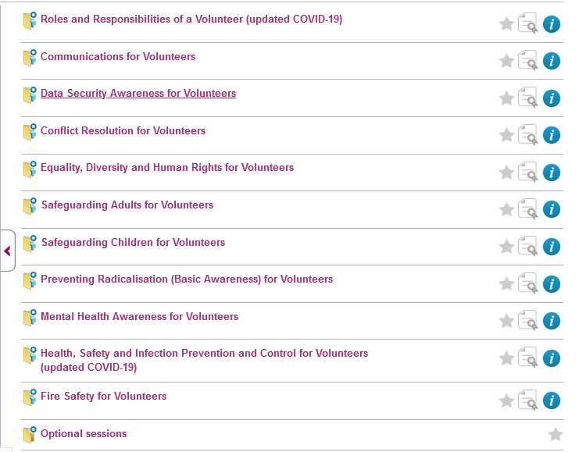

Free training available via e-Learning for Healthcare (1 of 3)
Recommended Volunteer Learning:
Hyperlink: Click here

Slide 14
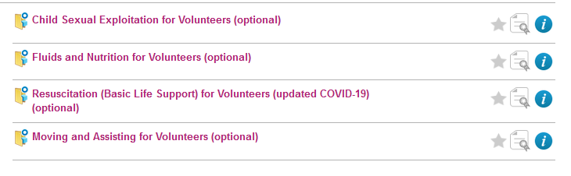

Free training available via e-Learning for Healthcare (2 of 3)
Optional sessions:
Hyperlink: Click here
Making Every Contact Count:
Hyperlink: Click here

Slide 15
Free training available via e-Learning for Healthcare (3 of 3)
Additional Courses can be found via the catalogue – other statutory/mandatory courses to be found include:
Display Screen Equipment: HEE elfh Hub (e-lfh.org.uk)
Information sharing: advanced information governance for frontline staff: HEE elfh Hub (e-lfh.org.uk)
Moving and Handling - Level 1: HEE elfh Hub (e-lfh.org.uk)
Full Catalogue: HEE elfh Hub (e-lfh.org.uk)

Slide 16
e-Learning for Healthcare: Step-by-Step volunteer registration guide
The Harrogate Hospital & Community Charity have produced a thorough step-by-step guide to volunteer registration.
Embedded PDF:
Hyperlink: Click here

Slide 17
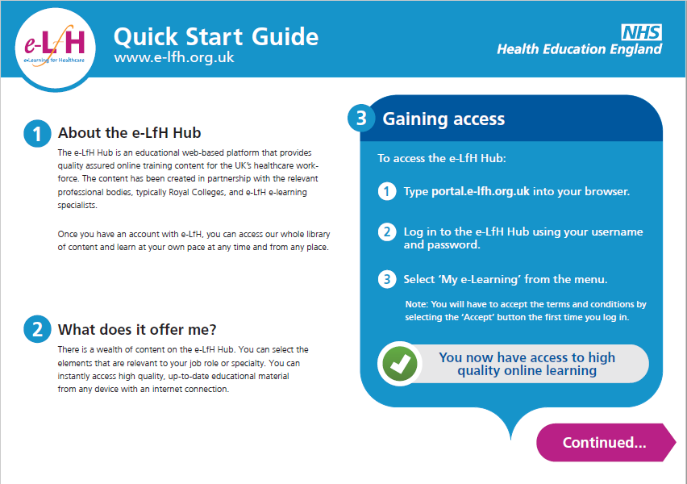
e-Learning for Healthcare: Quick Start Guide (1/2)

Slide 18
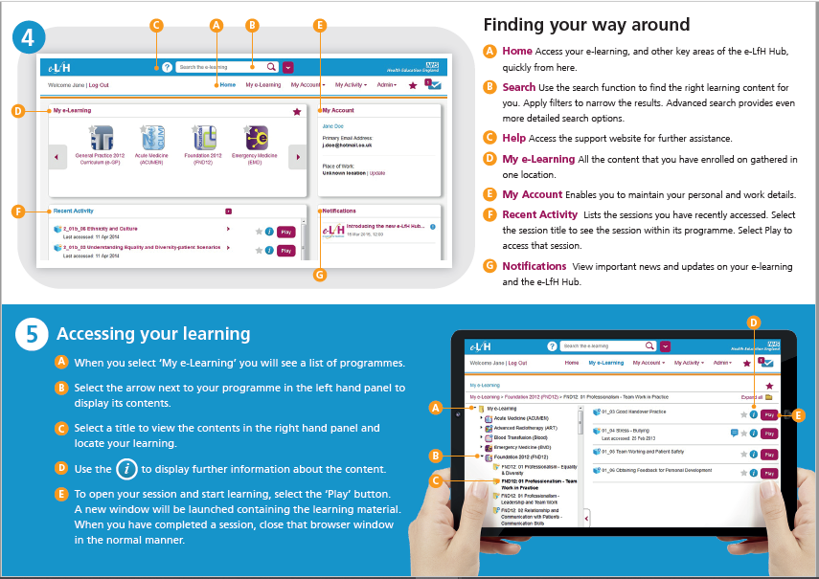
e-Learning for Healthcare: Quick Start Guide (2/2)

